Slide 1
AWS Shield
Managed DDoS Protection
Introduction to the Service: December 1, 2016

Slide 2

What is DDoS?
DDoS 101

Slide 3
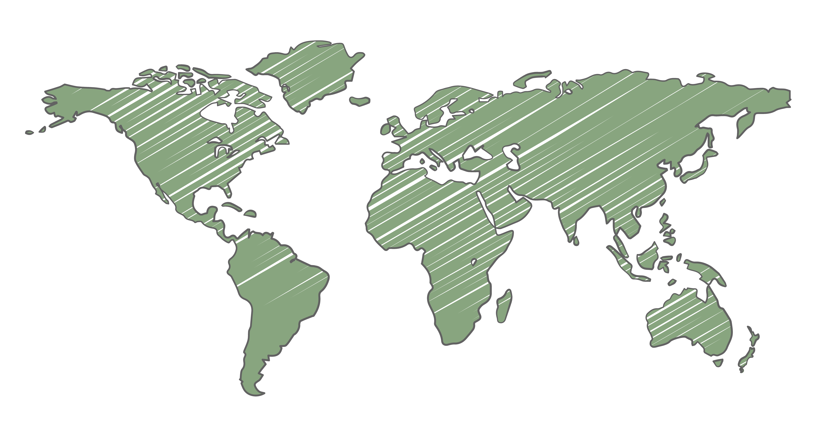




What is DDoS?
Distributed Denial Of Service

Slide 4
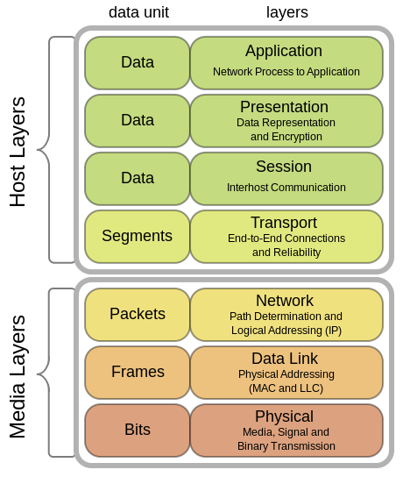
Types of DDoS attacks

Slide 5
Types of DDoS attacks
Volumetric DDoS attacks
Congest networks by flooding them with more traffic than they are able to handle (e.g., UDP reflection attacks)

Slide 6
Types of DDoS attacks
State-exhaustion DDoS attacks
Abuse protocols to stress systems like firewalls, IPS, or load balancers (e.g., TCP SYN flood)

Slide 7
Types of DDoS attacks
Application-layer DDoS attacks
Use well-formed but malicious requests to circumvent mitigation and consume application resources (e.g., HTTP GET, DNS query floods)

Slide 8
DDoS attack trends
20%
State exhaustion
65%
Volumetric
15%
Application layer

Slide 9
DDoS attack trends
20%
State exhaustion
65%
Volumetric
15%
Application layer
SSDP reflection attacks are very common
Reflection attacks have clear signatures, but can consume available bandwidth.

Slide 10
DDoS attack trends
20%
State exhaustion
65%
Volumetric
15%
Application layer
Other common volumetric attacks:
NTP reflection, DNS reflection, Chargen reflection, SNMP reflection

Slide 11
DDoS attack trends
SYN floods can look like real connection attempts
And on average, they are larger in volume. They can prevent real users from establishing connections.
20%
State exhaustion
65%
Volumetric
15%
Application layer

Slide 12
DDoS attack trends
20%
State exhaustion
65%
Volumetric
15%
Application layer
DNS query floods are real DNS requests
These can continue for hours and exhaust the available resources of the DNS server.

Slide 13
DDoS attack trends
20%
State exhaustion
65%
Volumetric
15%
Application layer
Other common application layer attacks:
HTTP GET flood, Slowloris

Slide 14
Challenges in mitigating DDoS attacks

Slide 15
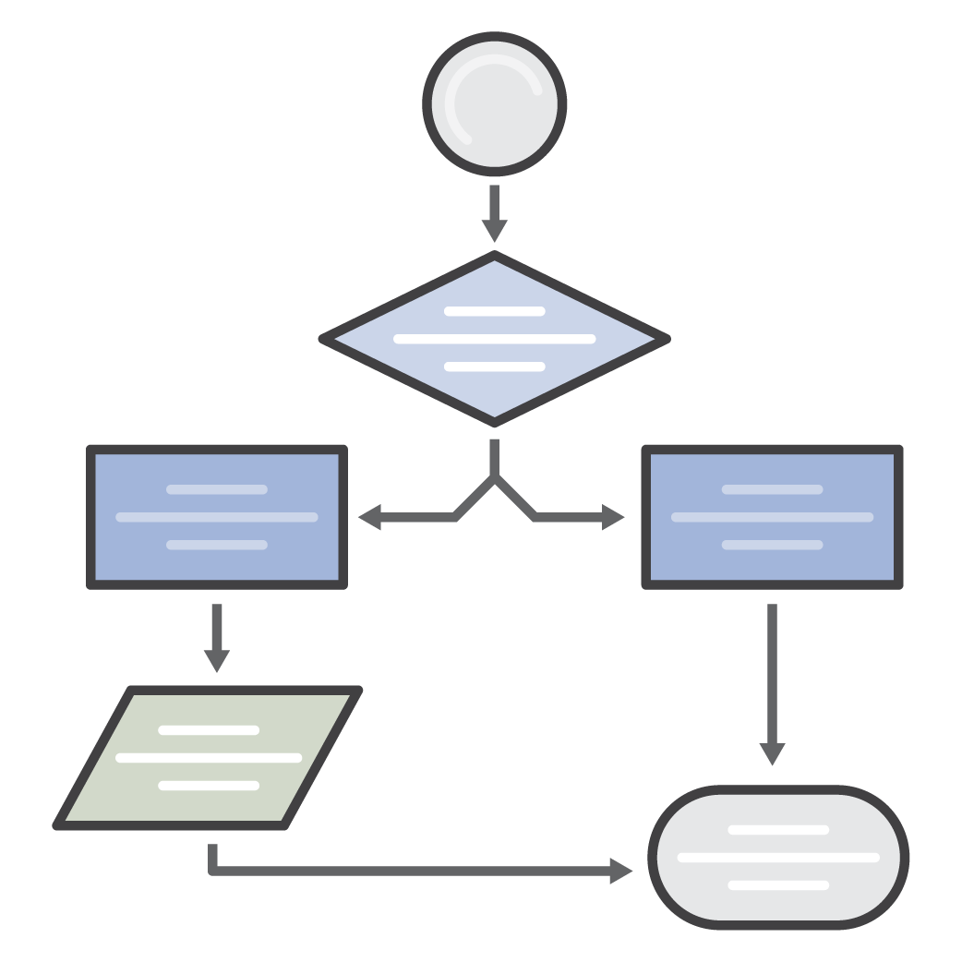


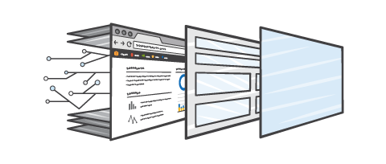
Challenges in mitigating DDoS attacks
Difficult to enable
Complex set-up
Provision bandwidth capacity
Application re-architecture

Slide 16




Challenges in mitigating DDoS attacks
Manual involvement
Traditional Datacenter
Operator involvement to initiate mitigation
Re-route traffic via distant scrubbing location
Increased time to mitigate

Slide 17

Challenges in mitigating DDoS attacks
Traffic re-routing = Increased latency for users
Traditional Datacenter

Slide 18

Challenges in mitigating DDoS attacks
Expensive to use

Slide 19
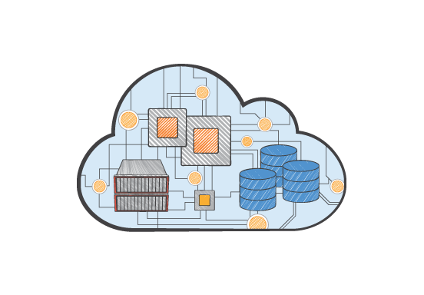

AWS approach to DDoS protection

Slide 20


At AWS, our goal has always been to …
Remove undifferentiated heavy-lifting
Ensure availability
Automatically protected against common attacks
AWS services are highly available

Slide 21
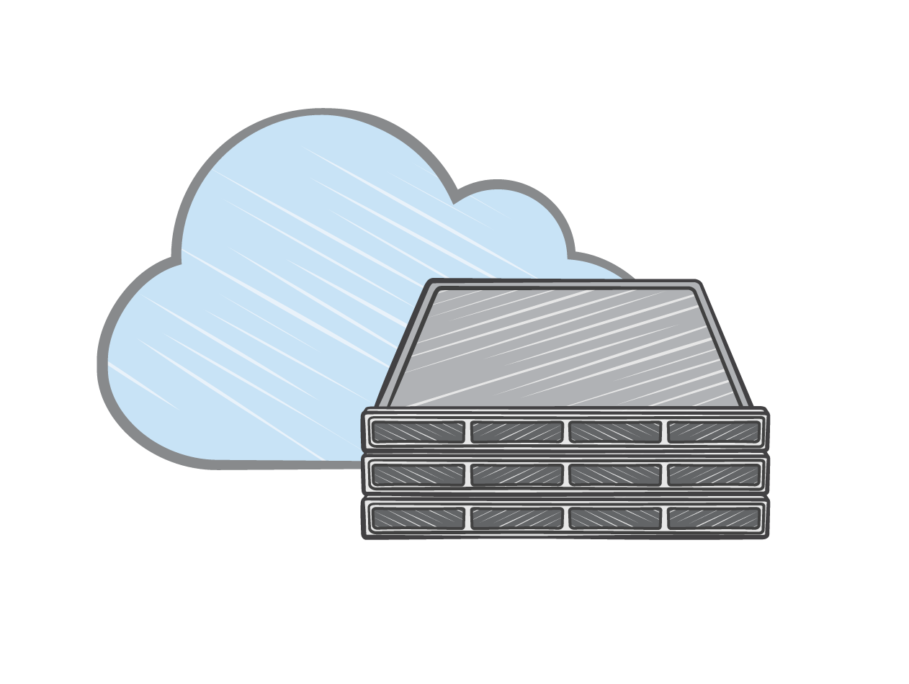


DDoS protections built into AWS
Integrated into the AWS global infrastructure
Always-on, fast mitigation without external routing
Redundant Internet connectivity in AWS data centers

Slide 22







DDoS protections built into AWS
Protection against most common infrastructure attacks
SYN/ACK Floods, UDP Floods, Refection attacks etc.
No additional cost
DDoS Attack
Users
DDoS mitigation
systems

Slide 23

Customers keep asking …
Does AWS protect me from application layer attacks?
What about large DDoS attacks?
Does AWS protect me from DDoS attacks?
How can I get visibility when I get attacked?
Scaling for DDoS attacks is expensive.
I want to talk to DDoS experts.

Slide 24
AWS Shield
A Managed DDoS Protection Service

Slide 25

AWS Shield
Standard Protection
Advanced Protection
Available to ALL AWS customers at No Additional Cost
Paid service that provides additional, comprehensive protections from large and sophisticated attacks

Slide 26
AWS Shield Standard

Slide 27

AWS Shield Standard
Layer 3/4 protection
Protect from most common attacks (SYN/UDP Floods, Reflection Attacks, etc.)
Automatically detect & mitigate
Built into AWS services
Layer 7 protection
AWS WAF for Layer 7 DDoS attack mitigation
Self-service & pay-as-you-go

Slide 28
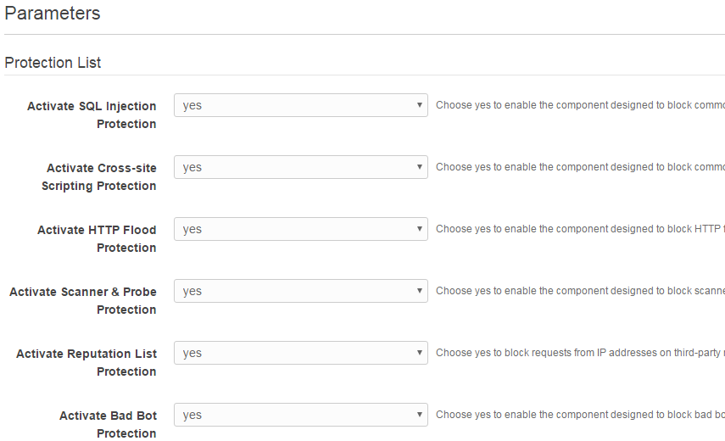
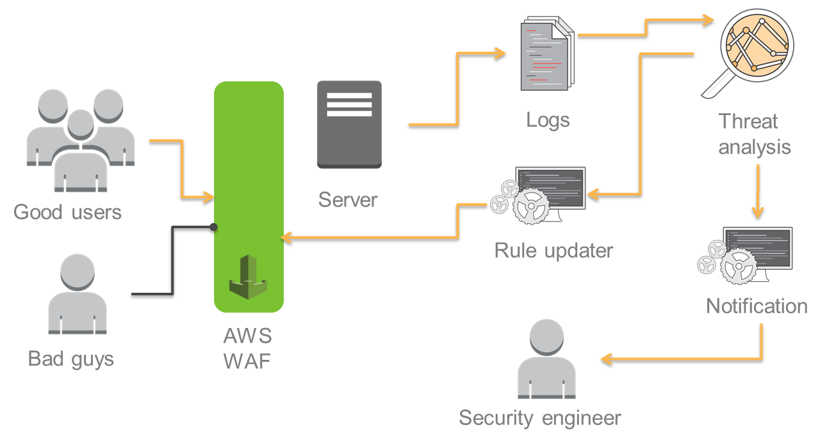
AWS Shield Standard
Quick Pre-Configured Protections
https://aws.amazon.com/answers/security/aws-waf-security-automations/
Advanced Automated Security

Slide 29
AWS Shield Standard
Better protection than ever for your applications running on AWS
Improved mitigations using proprietary BlackWatch systems
Additional mitigation capacity
Commitment to continuously improve detection and mitigation
Still at no additional cost

Slide 30
AWS Shield Advanced
Managed DDoS Protection

Slide 31
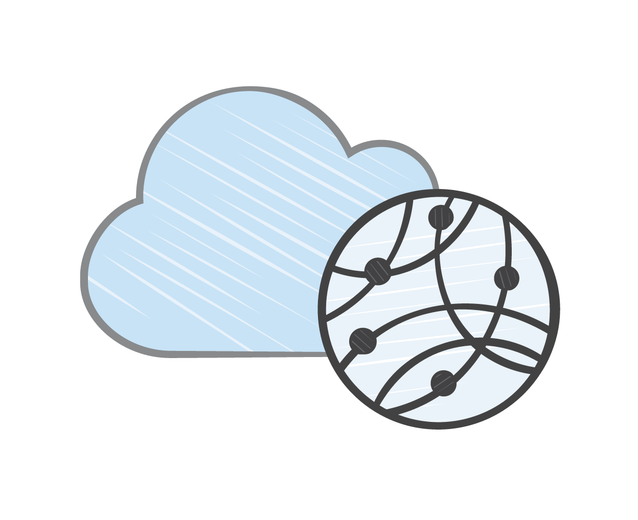


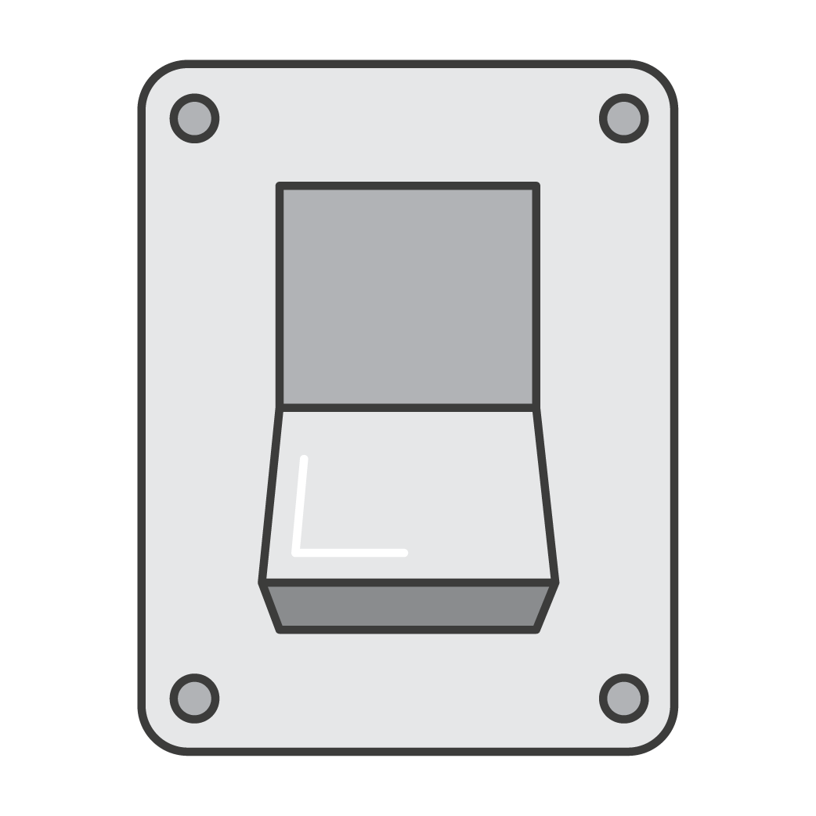
AWS Shield Advanced
Four key pillars…
AWS Integration
DDoS protection without infrastructure changes
Always-On Detection and Mitigation
Minimizes impact on application latency
Affordable
Don’t make trade-offs between cost and quality
Flexible
Customize protections for your applications

Slide 32
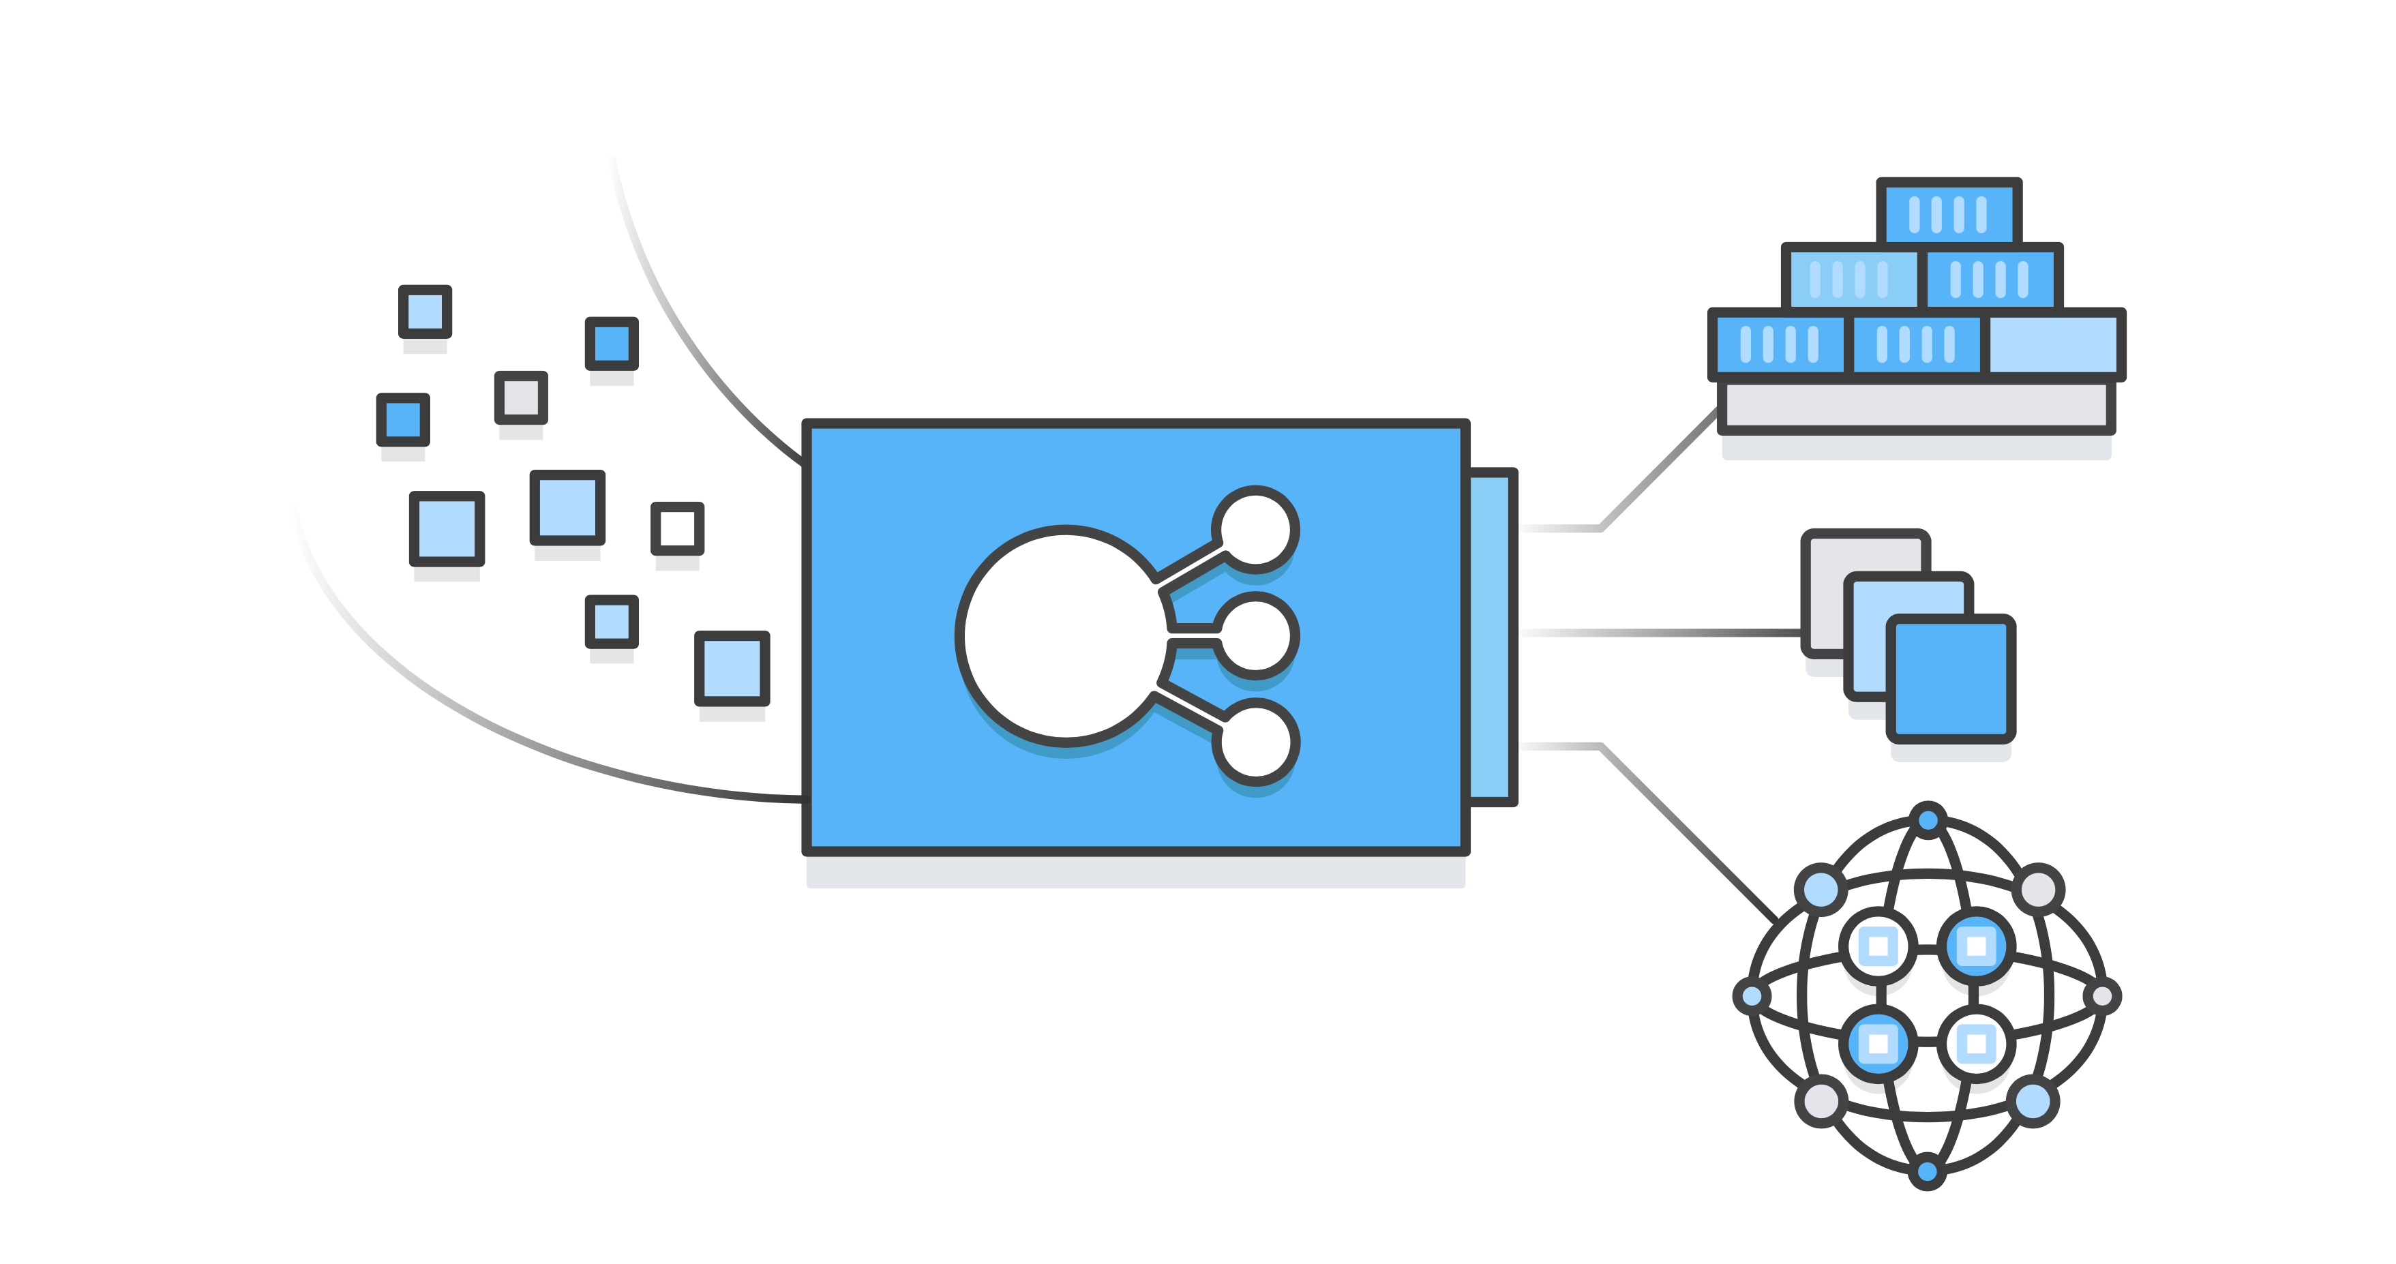
AWS Shield Advanced
Available today on..
Application Load Balancer
Classic Load Balancer
Amazon CloudFront
Amazon Route 53

Slide 33
AWS Shield Advanced
Always-on monitoring & detection
AWS bill protection
Advanced L3/4 & L7 DDoS protection
24x7 access to DDoS Response Team
Attack notification and reporting

Slide 34
AWS Shield Advanced
Always-on monitoring & detection
AWS bill protection
Advanced L3/4 & L7 DDoS protection
24x7 access to DDoS Response Team
Attack notification and reporting

Slide 35
AWS Shield Advanced
Always-on monitoring & detection
AWS bill protection
Advanced L3/4 & L7 DDoS protection
24x7 access to DDoS Response Team
Attack notification and reporting

Slide 36
AWS Shield Advanced
Always-on monitoring & detection
AWS bill protection
Advanced L3/4 & L7 DDoS protection
24x7 access to DDoS Response Team
Attack notification and reporting

Slide 37
AWS Shield Advanced
Always-on monitoring & detection
AWS bill protection
Advanced L3/4 & L7 DDoS protection
24x7 access to DDoS Response Team
Attack notification and reporting

Slide 38
AWS Shield Advanced
Always-on monitoring & detection
AWS bill protection
Advanced L3/4 & L7 DDoS protection
24x7 access to DDoS Response Team
Attack notification and reporting

Slide 39


Always-on monitoring and detection
Network flow monitoring
Application traffic monitoring

Slide 40

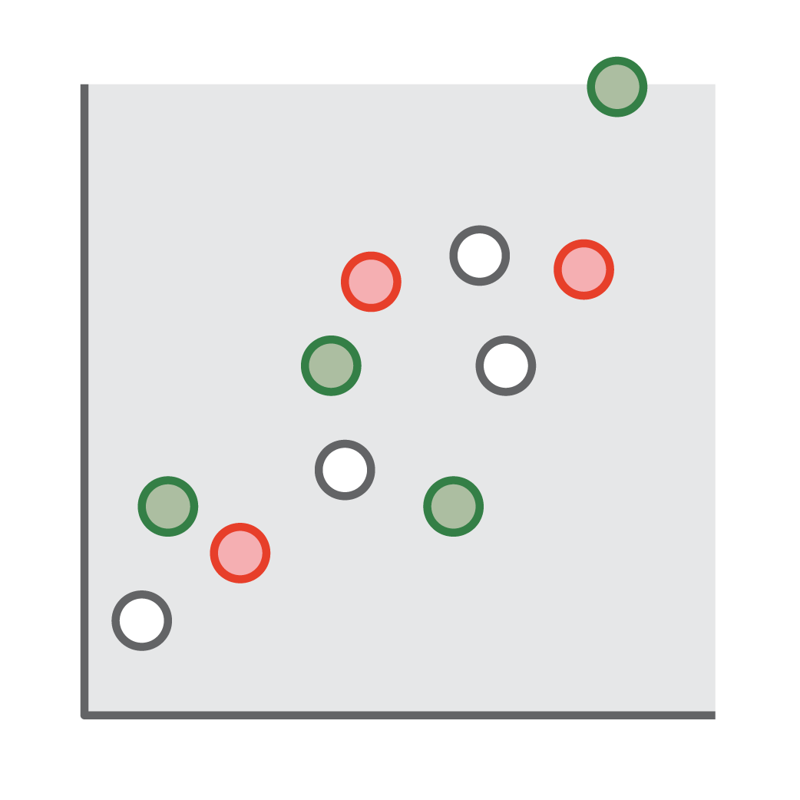

Always-on monitoring and detection
Signature based detection
Heuristics-based anomaly detection
Baselining

Slide 41
Always-on monitoring and detection
Heuristics-based anomaly detection
Detects anomaly based on attributes such as:
Source IP
Source ASN
Traffic levels
Validated sources

Slide 42
Always-on monitoring and detection
Baselining
Continuously baselining normal traffic patterns:
HTTP Requests per second
Source IP Address
URLs
User-Agents

Slide 43
AWS Shield Advanced
Always-on monitoring & detection
AWS bill protection
Advanced L3/4 & L7 DDoS protection
24x7 access to DDoS Response Team
Attack notification and reporting

Slide 44


Advanced DDoS protection
Layer 3/4 infrastructure protection
Layer 7
application
protection

Slide 45
Advanced DDoS protection
Layer 3/4 Infrastructure protection
Layer 7
Application
protection

Slide 46

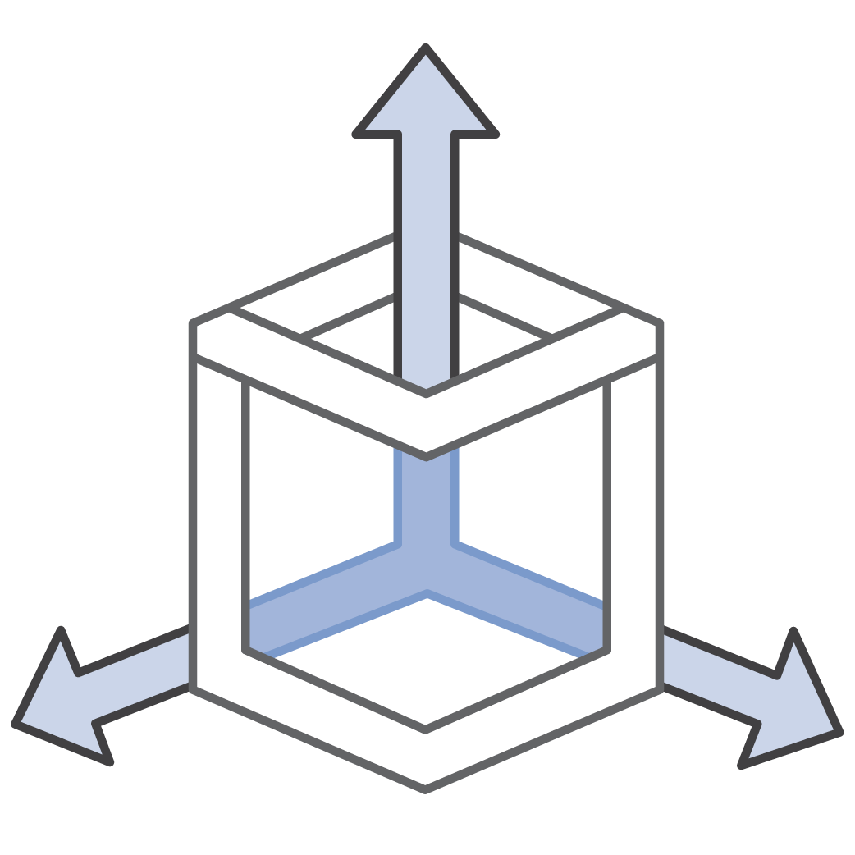
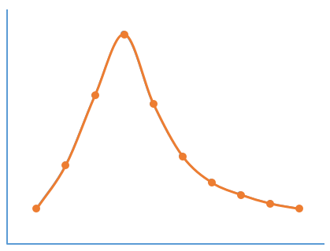
Layer 3/4 infrastructure protection
Advanced mitigation techniques
Deterministic filtering
Traffic prioritization based on scoring
Advanced routing policies

Slide 47
Layer 3/4 infrastructure protection
Deterministic filtering
Automatically filters malformed TCP packets
IP checksum
TCP valid flags
UDP payload length
DNS request validation

Slide 48
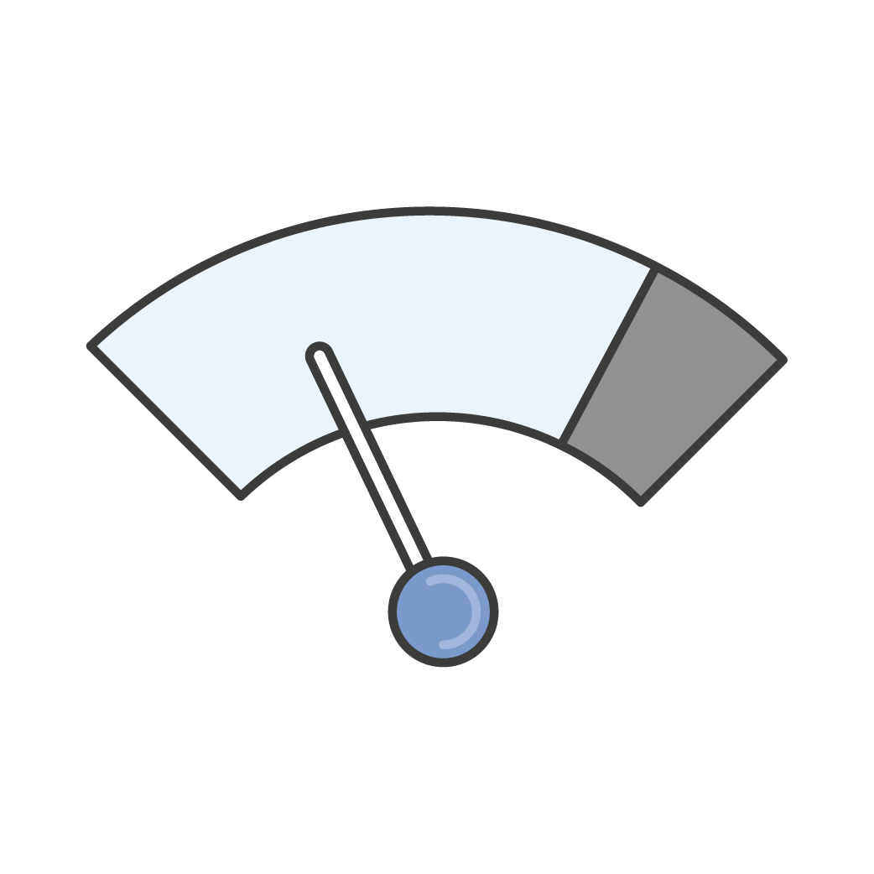

Layer 3/4 infrastructure protection
Traffic prioritization based on scoring
Low suspicion attributes
Normal packet or request header
Traffic composition and volume is typical given its source
Traffic valid for its destination
High suspicion attributes
Suspicious packet or request headers
Entropy in traffic by header attribute
Entropy in traffic source and volume
Traffic source has a poor reputation
Traffic invalid for its destination
Request with cache-busting attributes

Slide 49
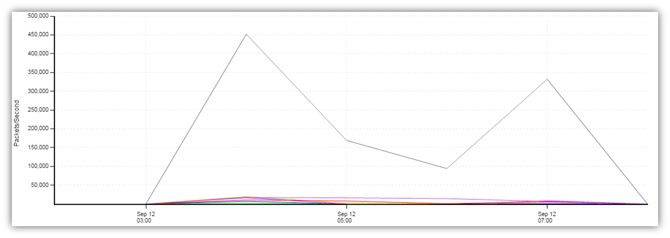
Layer 3/4 infrastructure protection
Traffic prioritization based on scoring
Inline inspection and scoring
Preferentially discard lower priority (attack) traffic
False positives are avoided and legitimate viewers are protected
High-suspicion packets dropped
Low-suspicion packets retained

Slide 50
Layer 3/4 infrastructure protection
Advanced routing policies
Distributed scrubbing and bandwidth capacity
Automated routing policies to absorb large attacks
Manual traffic engineering
Bring Additional mitigation capacity Inline for Large and Sophisticated DDoS Attacks

Slide 51
Advanced DDoS protection
Layer 3/4 Infrastructure protection
Layer 7
Application
protection

Slide 52
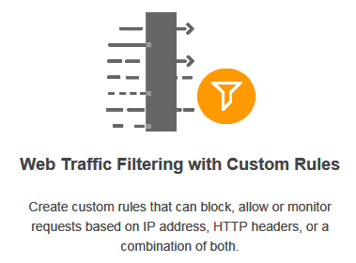
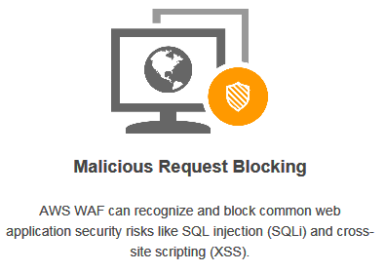
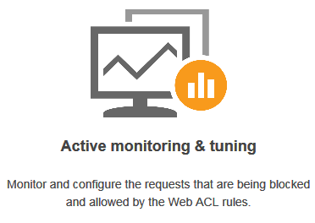
AWS WAF – Layer 7 application protection
Web traffic filtering with custom rules
Malicious request blocking
Active monitoring
and tuning

Slide 53




AWS WAF – Layer 7 application protection
Three modes of operation
Self-service
Engage DDoS experts
Proactive DRT engagement

Slide 54
AWS WAF – Layer 7 application protection
Self-service
AWS WAF included at no additional cost

Slide 55
AWS WAF – Layer 7 application protection
Engage DDoS experts
You engage the AWS DDoS Response Team (DRT)
DRT triages attack
DRT assists you with creating AWS WAF rules

Slide 56
AWS WAF – Layer 7 application protection
Proactive DRT engagement
Always-on monitoring engages the AWS DDoS Response Team (DRT)
DRT proactively triages DDoS attack
DRT creates AWS WAF rules (prior authorization required)

Slide 57
AWS Shield Advanced
Always-on monitoring & detection
AWS bill protection
Advanced L3/4 & L7 DDoS protection
24x7 access to DDoS Response Team
Attack notification and reporting

Slide 58
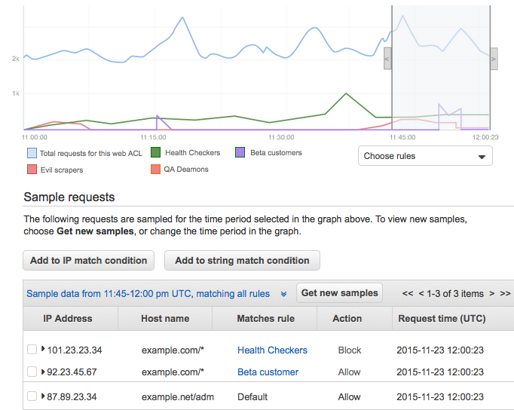


Attack notification and reporting
Real-time notification of attacks via Amazon CloudWatch
Near real-time metrics and packet captures for attack forensics
Historical attack reports
Attack monitoring and detection

Slide 59
AWS Shield Advanced
Always-on monitoring & detection
AWS bill protection
Advanced L3/4 & L7 DDoS protection
24x7 access to DDoS Response Team
Attack notification and reporting

Slide 60

24x7 access to DDoS Response Team
Critical and urgent priority cases are answered quickly and routed directly to DDoS experts
Complex cases can be escalated to the AWS DDoS Response Team (DRT), who have deep experience in protecting AWS as well as Amazon.com and its subsidiaries

Slide 61


24x7 access to DDoS Response Team
Before Attack
Proactive consultation and best practice guidance
During Attack
Attack mitigation
After Attack
Post-mortem analysis

Slide 62
AWS Shield Advanced
Always-on monitoring & detection
AWS bill protection
Advanced L3/4 & L7 DDoS protection
24x7 access to DDoS Response Team
Attack notification and reporting

Slide 63

AWS cost protection
AWS absorbs scaling cost due to DDoS attack
Amazon CloudFront
Elastic Load Balancer
Application Load Balancer
Amazon Route 53

Slide 64
Demo & Getting Started

Slide 65
AWS DDoS Shield: Pricing
Standard Protection
Advanced Protection
No commitment
No additional cost
1 year subscription commitment
Monthly fee: $3,000
Data transfer fees
 | Data Transfer Price ($ per GB)
 | CloudFront | ELB
First 100 TB | $0.025 | 0.050
Next 400 TB | $0.020 | 0.040
Next 500 TB | $0.015 | 0.030
Next 4 PB | $0.010 | Contact Us
Above 5 PB | Contact Us | Contact Us

Slide 66
AWS DDoS Shield: How to choose
Standard Protection
Advanced Protection
For protection against most common DDoS attacks, and access to tools and best practices to build a DDoS resilient architecture on AWS.
For additional protection against larger and more sophisticated attacks, visibility into attacks, and 24X7 access to DDoS experts for complex cases.

Slide 67

AWS Shield: Getting started
Standard Protection
Advanced Protection
You get it automatically
Enable via the AWS Console

Slide 69
Questions

Slide 70









AWS WAF – Layer 7 application protection
Self-service AWS WAF: Preconfigured protections
IP reputation lists
HTTP floods
Scanners and probes
Bots and scrapers
SQL injection
Cross-site scripting

Slide 71

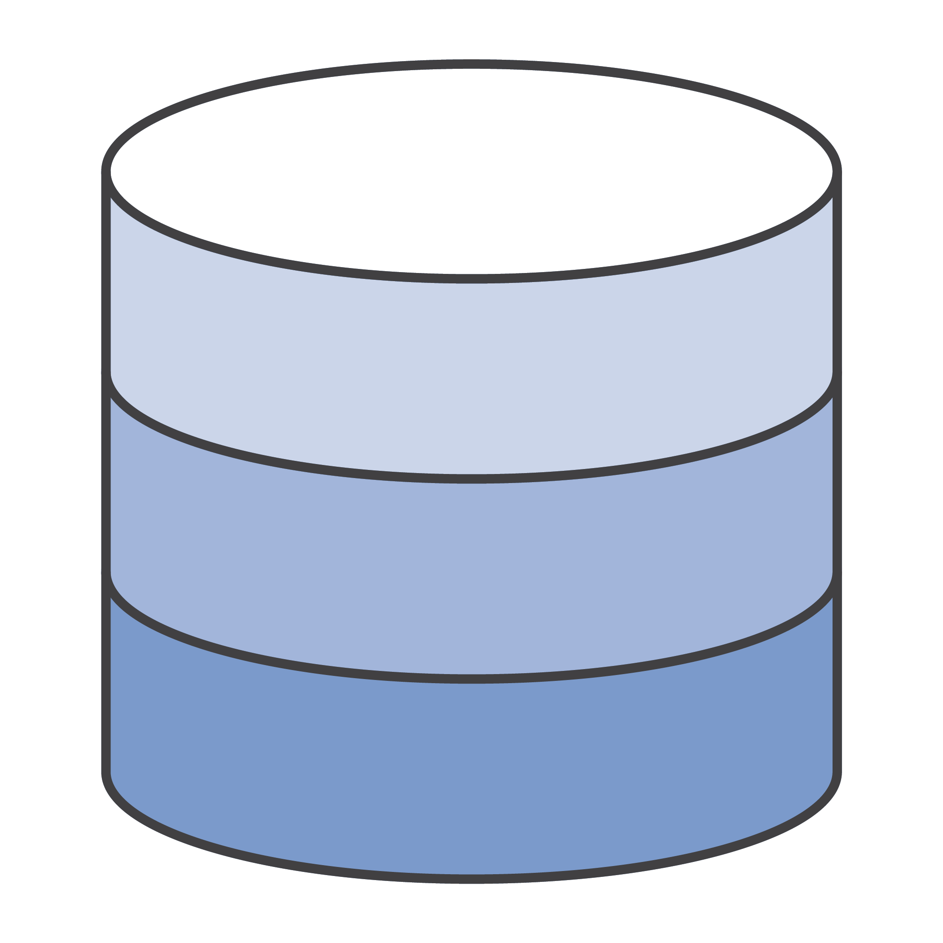

AWS WAF – Layer 7 application protection
Valid users
Web server
Database
Attackers

Slide 72
AWS WAF – Layer 7 application protection
Valid users
X
Web server
Database
Attackers
AWS WAF

